Slide 1

DL FINAL PROJECT
-Raniery, JB, Nikhil

Slide 2

W OR L??

Slide 3

W OR L??

Slide 4
IDEA
Is it a good stock or a scam?
Scrape posts from r/WallStreetBets (Popular Subreddit)
Predict if given post is well-researched stock or meme/bad stock
Multiple models and architectures to attempt to predict quality of a Reddit post and the stock it speaks of.
Notes:
The term ``shitpost'' is used here to
describe content that is typically of low quality or relevance.
It is recognized as colloquial and somewhat informal language within online communities.
The use of this term is intended for analytical accuracy based on common usage,
and is not meant to offend or detract from the professionalism of the discourse.

Slide 5
HYPOTHESIS
Posts that have good research put into them will have more likely result in positive stock returns while meme stocks will most likely result in negative stock returns
For example:
Apple: Good stonk
Gamestop: Meme stonk

Slide 6
DATA COLLECTION
Scraped 27TB of Reddit data
3 Million posts of r/WallStreetBets collected between 2019 and May 2024
~300,000 posts that satisfy our criteria
~47,000 good stock posts
~48,000 bad stock posts

Slide 7
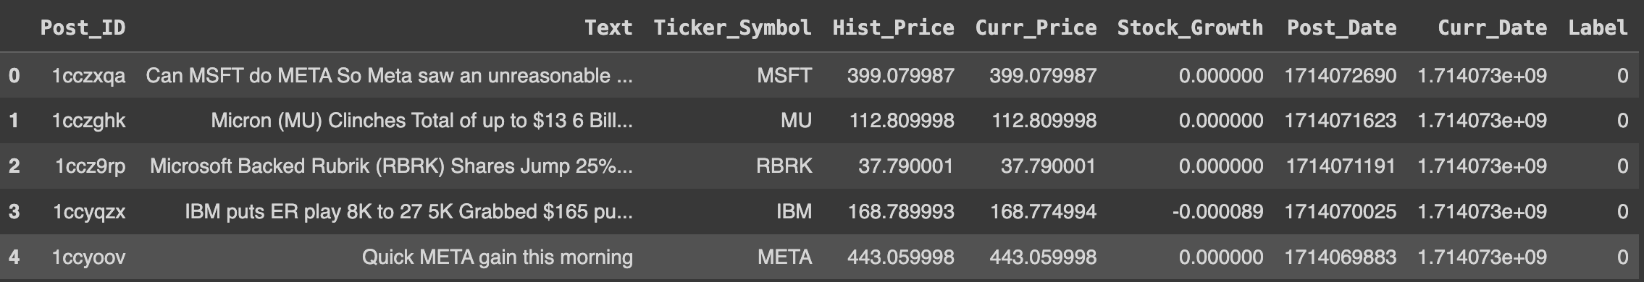
EDA - DATAFRAME
~300k posts and 9 columns.
Label 0 – bad stock and label 1- good stock.

Slide 8
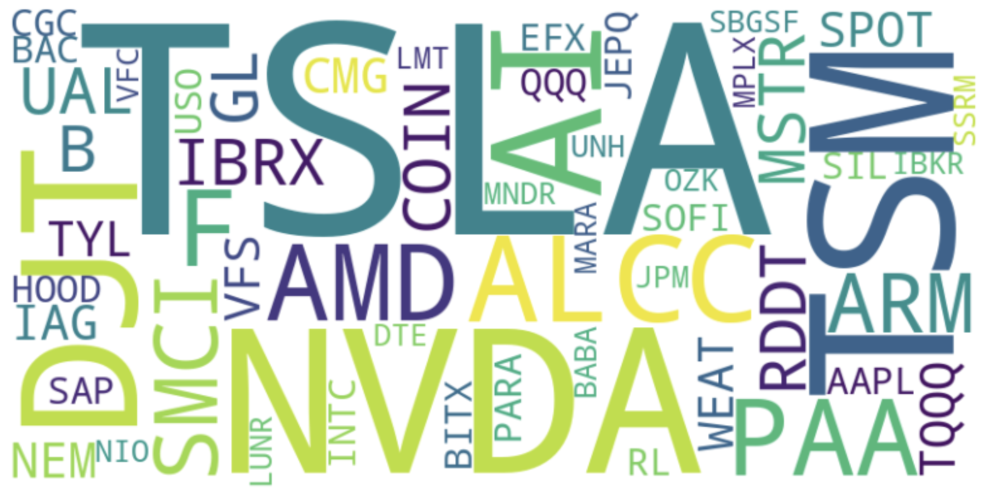
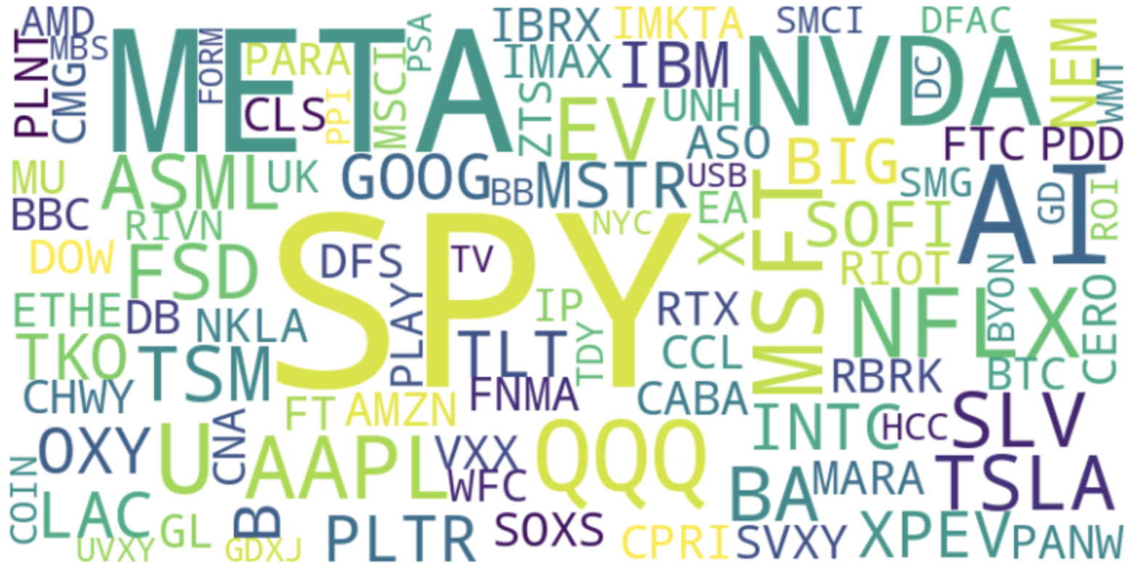
EDA - WORDCLOUDS
GOOD STONK
BAD STONK

Slide 9
MODELING
Supervised - Naïve-Bayes
Unsupervised – K-Means Clustering
Deep Learning – Simple Feed Forward Network
Deep Learning – LSTM
Deep Learning – Transformer

Slide 10
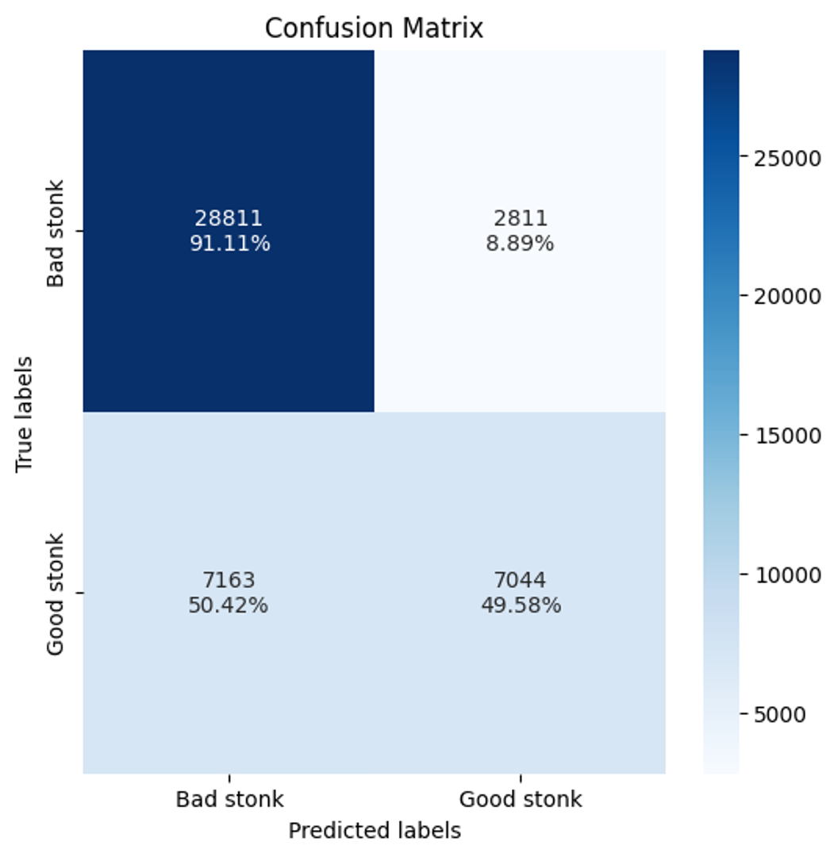
NAÏVE-BAYES
Sci-Kit Learn to tokenize and model data (MultinomialNB())
Accuracy_score() yields an accuracy of 80.2%
Confusion matrix insights:
Good accurate classifications
High false positive rate

Slide 11
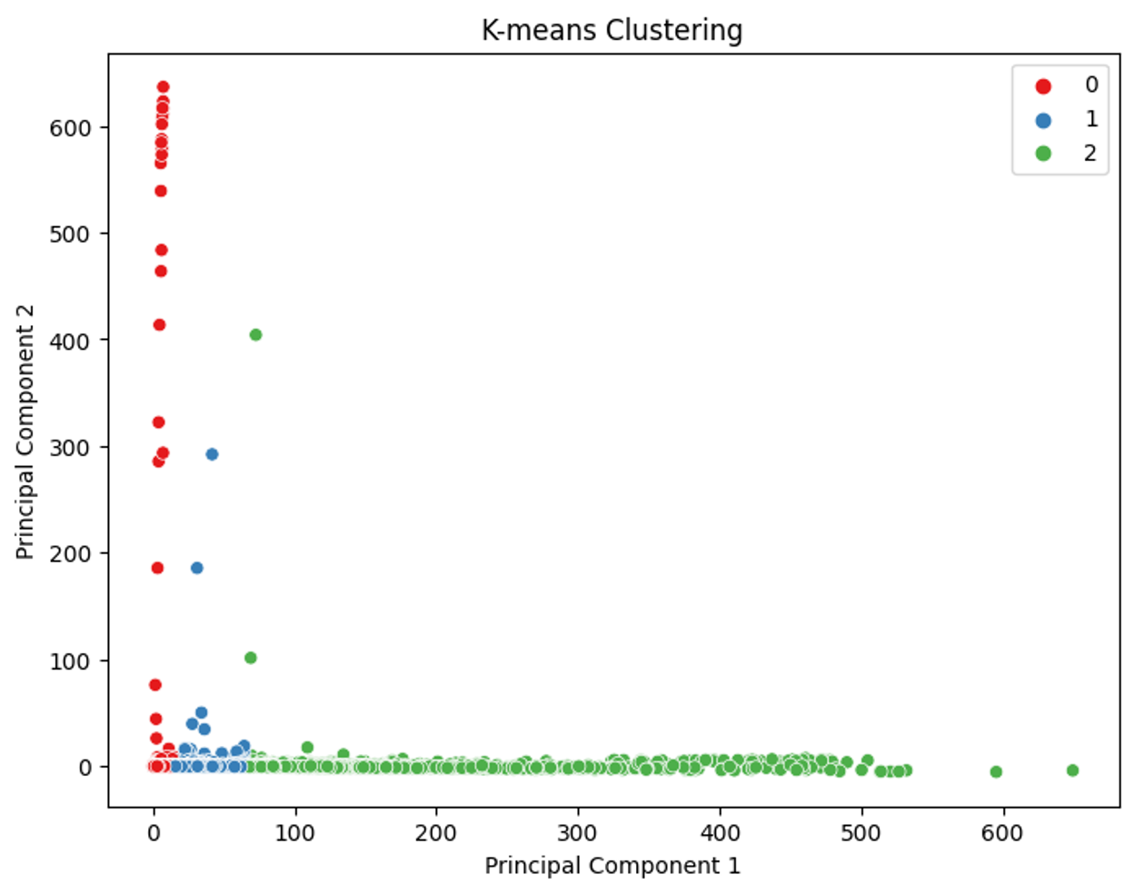
K-MEANS
Sci-kit Learn to tokenize and modeling.
Optimize for best number of clusters – 3.
Silhouette score of 0.72
Run PCA to visualize clusters

Slide 12
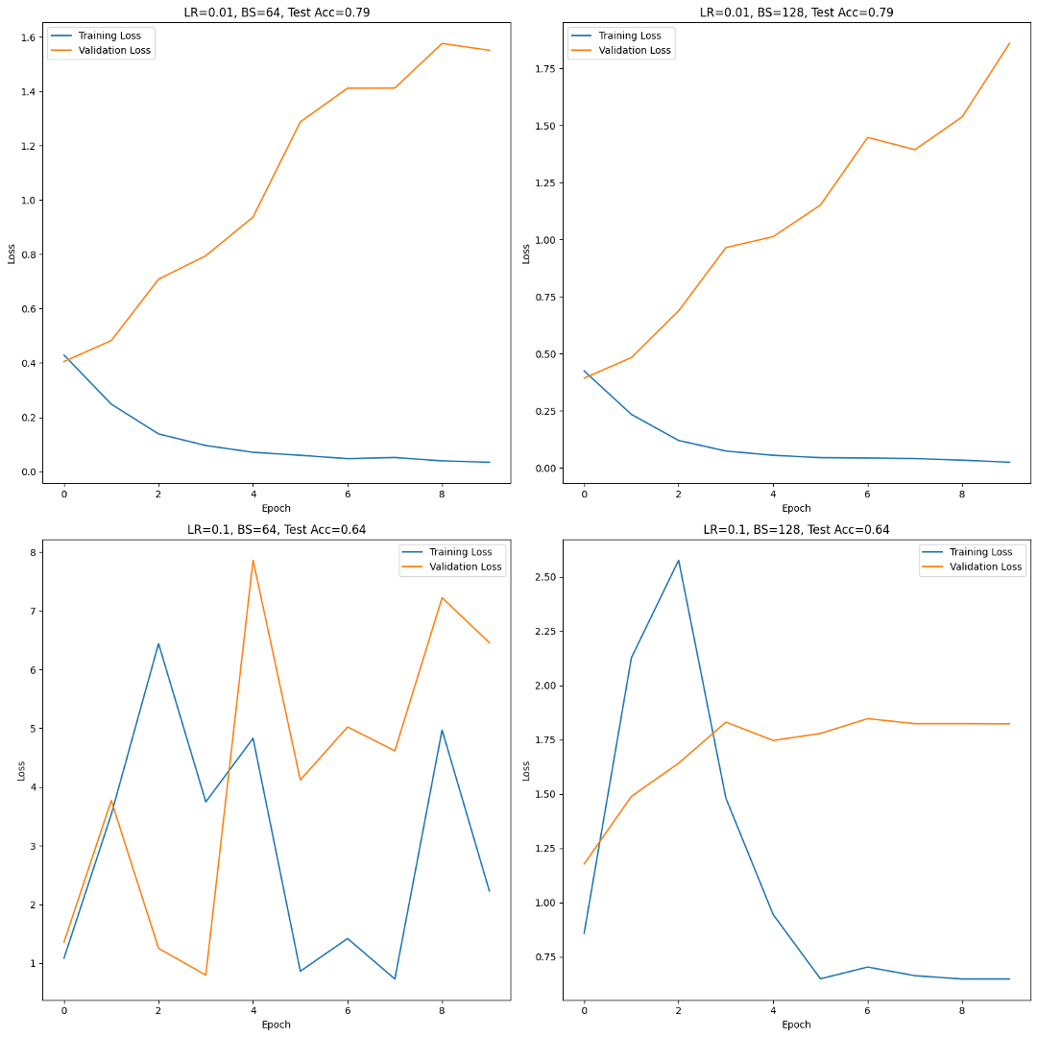
SIMPLE FEED FORWARD NETWORK
Keras to create architecture.
Embedding Layer – size of input
Dense Layer – 64 neurons with ‘ReLU’ Activation
Output Layer – 1 neurons with ‘Sigmoid’ Activation
Hyperparameter Optimization
Learning rates of 0.01 and 0.1
Batch sizes of 64 and 128
Accuracy on test set: 79%

Slide 13
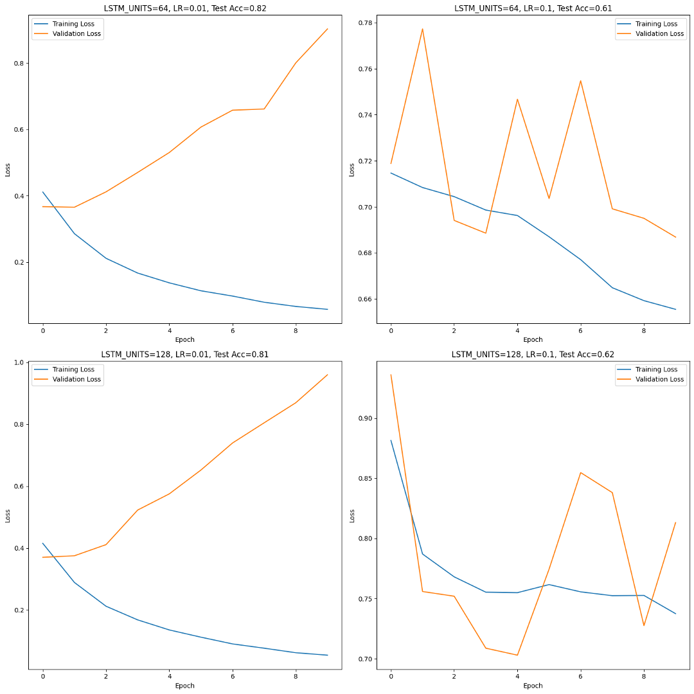
LSTM
Keras to create architecture.
Embedding Layer – size of input
LSTM Layer
Output Layer – 1 neurons with ‘Sigmoid’ Activation
Hyperparameter Optimization
Learning rates of 0.01 and 0.1
Batch sizes of 64 and 128
Accuracy on test set: 8.14%

Slide 14
TRANSFORMERS

Slide 15
TAKEAWAYS
Best Classification model:
Long Short-Term Memory (LSTM) Model
Better accuracy than Naïve-Bayes and SFFN
For faster classifications:
Naïve-Bayes

Slide 16
FUTURE STEPS
Explore other models
Better NLP preprocessing
Model Testing:
ChatGPT/LLM to create a test Subreddit post
Test post on model

Slide 17
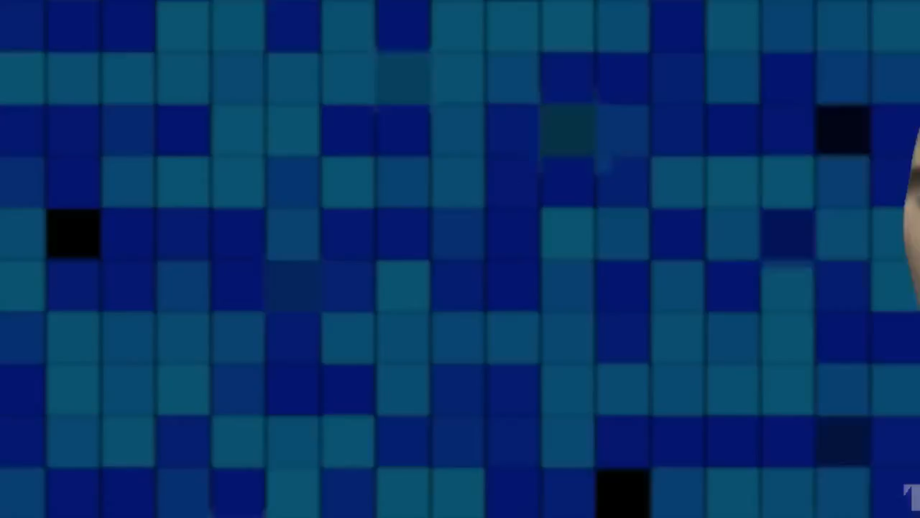
THANK YOU!

